Slide 1
Team 2: Literary Paradox Miners
Final Project Presentation. Johns Hopkins University. Fall 2021
Deep Neural Networks
Kaggle Competition: Contradictory, My Dear Watson
Jeff Simon, Yaron Walfish, Sina Azartash, Linshen Wu

Slide 2
Competition Description
Can machines determine the relationships between sentences, or is that still left to humans?
Classify pairs of sentences (a premise and a hypothesis) into three categories - entailment, contradiction, or neutral using GPU.
Entailment (logically requires)[1]:
A entails B if the truth of A requires that B is true.
A: I will turn 37 this year, B: I am currently living, A entails B.
Profound implications for examples such as fact-checking, identifying fake news, and analyzing text
Competition URL: https://www.kaggle.com/c/contradictory-my-dear-watson

Slide 3
Our Team
Member Duties:
Yaron Walfish: improved the model, focused on model structure
Jeff Simon: improved the model, focused on model structure
Linshen Wu: presentation editor, improved the model, focused on overfitting
Sina Azartash: presentation and research
Our Strategy:
Convert sequences of words into numbers
Create 2 separate models: one for english and one for all languages
Find the best pretrained model for our dataset
Use Transfer Learning
Used several strategies to improve our Transformer Model
Fine-tune Our Model

Slide 4
Final Project URLs
English model and EDA notebook:
https://colab.research.google.com/drive/1u9a5kD0NtsGR3mltaFlT_aTXybVRe5ax
Multi-language notebook: https://colab.research.google.com/drive/1qiR2ImnIZ3buQXE6dnCPKpM9-RxCcRF_#scrollTo=9o8D4eUIgQs5
Submission notebook:
https://colab.research.google.com/drive/1zTK2tK817x8Zll9HumvmN_ZoeXhkmbBP#scrollTo=9o8D4eUIgQs5
Final presentation on Youtube:
https://www.youtube.com/watch?v=stZ_85s3Gss
Notes:
We can see that the English Model Layer and Multi Language Model Layer have essentially the same architecture

Slide 5

Acronyms
TN
True Negative
NLI
TP
Natural Language Inferencing
True Positive
NLP
FN
Natural Language Processing
False Negative
EDA
FP
Exploratory Data Analysis
False Positive

Slide 6
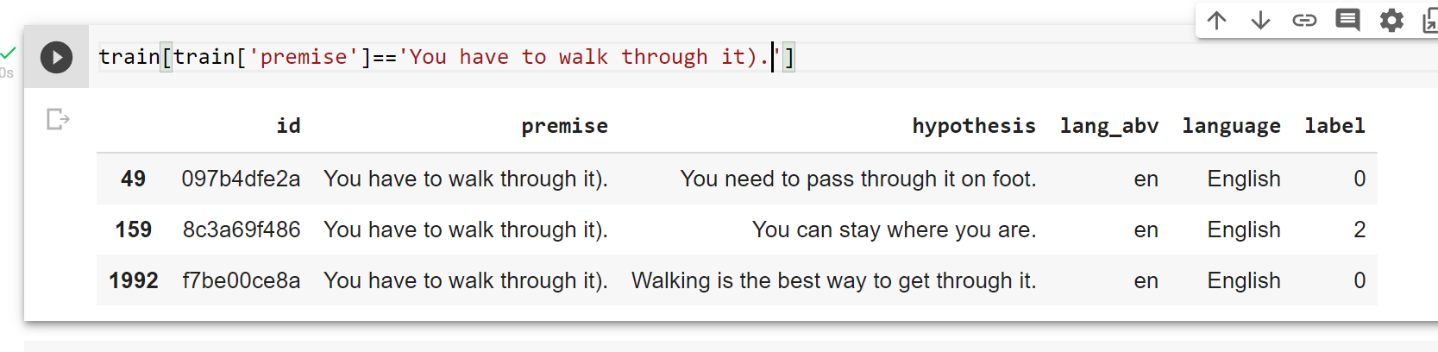
Key Features
Input Features:
Premise: sentence 1 with 8209 unique values
Hypothesis: sentence 2 with 12119 unique values
Language: 15 different languages
Note: the same premise could associate with different hypothesis and label as:

Slide 7
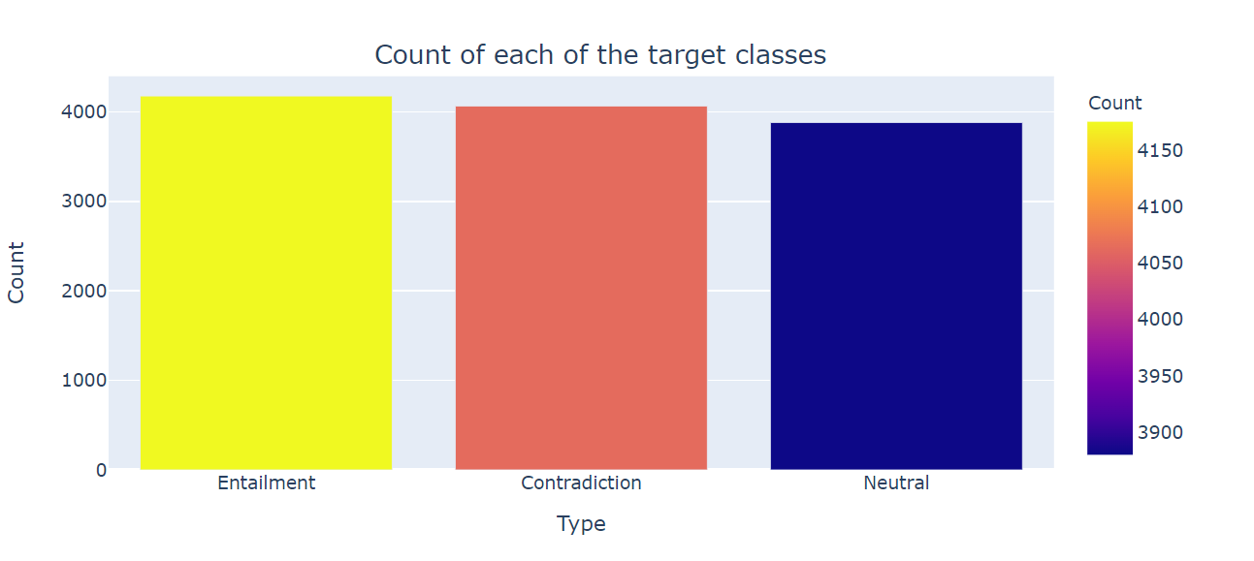
EDA
Observation:
The training set contains three different target labels with 12120 total records as:
4176 Entailment
4064 Contradiction
3880 Neutral

Slide 8
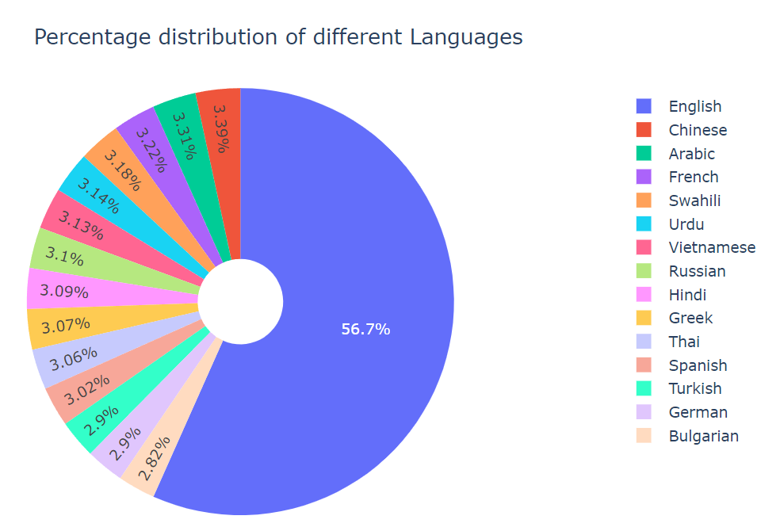
EDA
Observation on training data:
There are total of 15 different languages
Major language is English: 56.7%
Rest of languages range: 2.82% ~ 3.39%

Slide 9
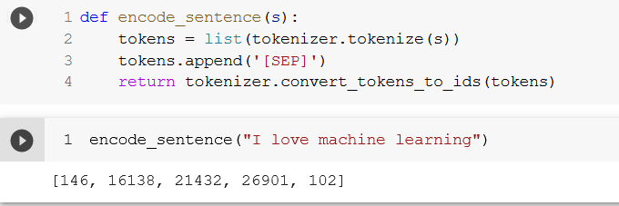
Preprocessing
Tokenizer: sequence of words → numerical representations
We are using an NLI version of Roberta. Roberta is a more specific version of BERT
ROBERTA uses three kinds of input data: input word IDs, input masks, and input type IDs.
These inputs help the tokenizer to ignore padding and distinguish the premise and hypothesis
For proper tokenization, pad all of the inputs to be the same size.
The [CLS] token denotes beginning of the input, [SEP] token denotes separation between the premise and the hypothesis.

Slide 10
The Pretrained Model
Two pretrained models are used for preprocessing: roberta-large-mnli & xlm-roberta-large-xnli [2]
Both are the same model, but use different pretrained weights
Roberta-large-mnli - english pretrained weights
xlm-roberta-large-xnli - multilanguage pretrained weights
Documentation: https://github.com/pytorch/fairseq/blob/main/examples/roberta/README.md
Download URL: https://dl.fbaipublicfiles.com/fairseq/models/roberta.large.mnli.tar.gz

Slide 11
Transfer Learning
Pretrained Weights [7]
Weights from the two pre-trained models below were loaded and further trained on the given data.
The models were trained fully with no frozen layers.
English Model Layers
Input: shape has a max length = 120
Encoder = roberta-large-mnli
Pooling = GlobalAveragePooling1D
Output: 3 units, softmax , L1 regularization
Multi Language Model
Input = shape has a max length = 120
Encoder = xlm-roberta-large-xnli
Pooling = GlobalAveragePooling1D
Output: 3 units, softmax , L1 regularization

Slide 12
Our Model Parameters
L1 regularization with a penalty = .01 (default value)
L1 = Lasso Regression. Calculates the absolute value of the coefficients which means some features can potentially be eliminated entirely [8]
Sparse Categorical Cross Entropy Loss [6]
We use this loss function when there are two or more label classes
Targets are represented by the index of the category
More efficient than Categorical_Cross_Entropy for NLP due to many categories
Adam Optimizer [5]
adaptively estimates first and second moment (explain moments)
Separate step size for each derivative of the gradient
Learning rate adapts itself
Learning Rate Schedule [9]
Customized defined learning rate that changes over the batches
Appropriate for Adam?
“The marginal value of adaptive gradient methods in machine learning”
The article summarizes that a customized learning schedule can generalize better than the built in adaptive method
Exponential Decay - decreases faster at the beginning and then flattens out later
Starts with 2 E - 6 Learning Rate
Learning rate decays by 0.9 every 1000 batches
Notes:
We can see that the English Model Layer and Multi Language Model Layer have essentially the same architecture

Slide 13
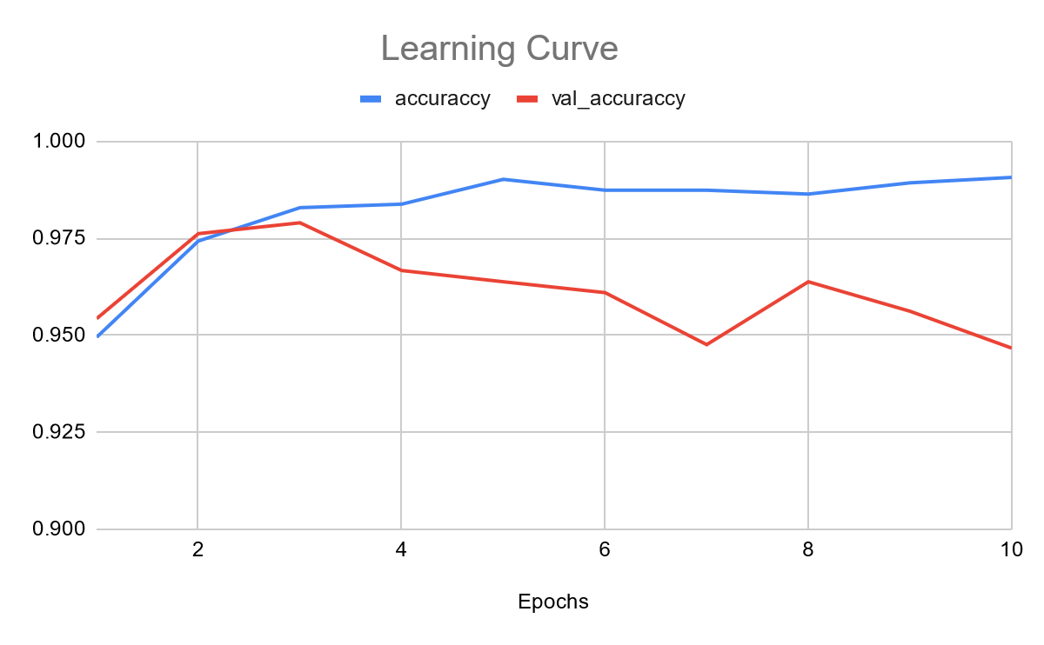
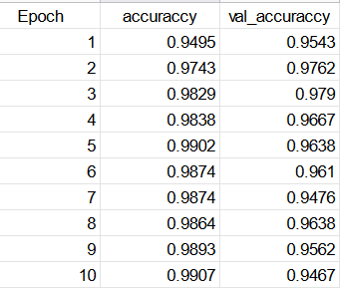
Learning Curve
3 epochs was most optimal

Slide 14
Team Performance
LB URL: https://www.kaggle.com/c/contradictory-my-dear-watson/leaderboard
Metric: Accuracy: the percentage of correct prediction.
Formula: Accuracy = (all correct) / all = (TP + TN) / (TP + TN + FP + FN)
As of: | 10/18 | 10/25 | 11/1 | 11/8 | 11/15 | 11/22 | 11/29 | 12/6 | Final Score
LB score | 0.64600 | 0.65158 | 0.70202 | 0.93070 | 0.93089 | 0.93493 | 0.93705 | 0.94051 | 0.94051
LB rank | 38 | 32 | 32 | 11 | 9 | 8 | 6 | 8 | 8
Entries | 3 | 2 | 3 | 4 | 4 | 3 | 2 | 3 | 3
Knowing the true rank was difficult as some of the top models seemed to be periodically removed by Kaggle Admin. At the time of our Final Score, the top two contestants had accuracy values above 99%.

Slide 15
Modeling Challenges Below 90%
The Kaggle Competition recommended a TPU, but we found that for embeddings and transformer architectures to be very slow. Using a GPU improved runtime significantly.
Using a single multi language model was successfully deployed with accuracy up to 93%! Unfortunately, this caused the model to become infeasible due to very long train time.
Two vectors were run through our Neural Network: a separate embedding for the premise and hypothesis using SBERT. This actually made things worse.
Utilizing two models (English and non-English) within a single collab session is not possible due to memory constraints. Weights must be saved outside of collab and reloaded for each session. The weight files are large (each 3-4GB)

Slide 16
Modeling Challenges Below 90%
Overfitting: a high training accuracy of around 98% was achieved within 2 epochs, when our test accuracy was around 90%
We found that dropout (with a rate of 0.1) did not improve the model.
→ Other nodes are not compensating for each other
We tried Nadam Optimizer and Adam actually did better
→Nadam Optimizer is just Adam with Nesterov momentum, also called Nesterov Accelerated Gradient/NAG [4]
Momentum is added to both current gradient position and gradient change
Result is gradient is based on new position rather than current position

Slide 17
Modeling Challenges Above 90%
Once accuracy rose above 90%, we encountered unique challenges:
Aurélien Géron in “Hands-On Machine Learning” recommend training our output layer weights with a high learning rate using the weights from the frozen pretrained model. Then with a much smaller learning rate, training all the layers together. Unfortunately, freezing several different numbers of layers all did not improve accuracy
Improving the Multi-language model was much more difficult than improving the English only model
Multi-language had a smaller dataset
Our validation set failed to have a meaningful effect:
Validation set was 20% of our data which further exacerbated the under-representation of some languages in the Multi-Language Set
The tuning on just 20% of the data failed to capture how to fix the few misclassified examples

Slide 18
Modeling Challenges Above 90%
Several strategies that normally increased accuracy failed to have effect
Additional hyper-parameter tuning and changing the number of top layers
GlobalAverage Pooling was more effective than both max and average pooling
Increasing the epochs required a with a tradeoff in learning rate
We tests several epochs ranging from 1-10
Too many epoch resulted in overfitting, too low resulted in low accuracy, we settled around 4 epochs
We reached an ostensible cap in accuracy at 93%, so we tried dramatically different architectures:
We tested numerous additional pretrained models for transfer learning in order to find the best model for our data.
We tested on 1 model instead of our usual two models and were able to get to a matching 93%

Slide 19
Discussion
If we had more time, we would consider several more directions:
Custom Model: Of course, while the pretrained models were useful, a custom model specific to this dataset would likely produce much higher accuracy values
Segmentation: We believed the a major source of error was not making classifications specific enough to misclassified examples. Therefore, we planned to first segment our data and then run a ensemble of models for each segment
Segment our dataset for each language or collection of similar languages
Segment our dataset using decisions trees
Segment our dataset using clustering
Identifying and then filtering our phrases or words in a sentence that were least likely to cause overfitting and entailment
Mitigate Overfitting: On the contrary, a larger problematic theme was insufficient generalization
We needed to to capture more patterns between words in a sentence.
Longer sentence sizes → captured by larger batch size → more memory
Our current batch size was at 16 which meant our model would generalize patterns based on 16 weights, if we could increase the batch size, then we could capture more patterns
One of our competitors was processing full sentences
We estimated that this would require about 64 GB of GPU memory with 32 capturing most sentences.
Our limitation was we were running about 14.88 GB of GPU for half sentences with Colab Pro Plus

Slide 20

Q & A
We are happy to answer your questions! Please email us:
Sina Azartash sazarta1@jh.edu
Jeff Simon jsimon34@jhu.edu
Linshen Wu lwu53@jhu.edu
Yaron Walfish ywalfis1@jhu.edu

Slide 21
References
Entailment | Linguistics | Glossary | Ultius. (2021). Entailment. https://www.ultius.com/glossary/linguistics/entailment.html
Briggs, J. (2021, September 2). Train New BERT Model on Any Language | Towards Data Science. Medium.
https://towardsdatascience.com/how-to-train-a-bert-model-from-scratch-72cfce554fc6
NoteBooks Grandmaster, Mr_KnowNothing. (2020, April 13). Deep Learning For NLP: Zero To Transformers & BERT. Kaggle. https://www.kaggle.com/tanulsingh077/deep-learning-for-nlp-zero-to-transformers-bert#BERT-and-Its-Implementation-on-this-Competition
Schmidt, D. (2018, November 23). Understanding Nesterov Momentum (NAG). Dominik Schmidt. https://dominikschmidt.xyz/nesterov-momentum/

Slide 22
References
Brownlee, J. (2021, October 11). Gradient Descent Optimization With Nadam From Scratch. Machine Learning Mastery. https://machinelearningmastery.com/gradient-descent-optimization-with-nadam-from-scratch/
tf.keras.losses.SparseCategoricalCrossentropy | TensorFlow Core v2.7.0. (2021). TensorFlow. https://www.tensorflow.org/api_docs/python/tf/keras/losses/SparseCategoricalCrossentropy
Gupta, D. (2021, January 4). Transfer Learning | Pretrained Models in Deep Learning. Analytics Vidhya. https://www.analyticsvidhya.com/blog/2017/06/transfer-learning-the-art-of-fine-tuning-a-pre-trained-model/
S. (2020, July 7). Regularization: Simple Definition, L1 & L2 Penalties. Statistics How To. https://www.statisticshowto.com/regularization/
Ashia C. Wilson, Rebecca Roelofs, Mitchell Stern, Nathan Srebro, and Benjamin Recht. 2017. The marginal value of adaptive gradient methods in machine learning. In Proceedings of the 31st International Conference on Neural Information Processing Systems (NIPS'17). Curran Associates Inc., Red Hook, NY, USA, 4151–4161.

Slide 23
Deep Neural Networks: EN.605.742.81.FA21
EN.605.742.81.FA21 DEEP NEURAL NETWORKS
Jeff Simon, Yaron Walfish, Sina Azartash, Linshen Wu
Final Project

